Slide 1
Parent Community
Introduction to
SOGI-Inclusive Education
SOGIeducation.org #sogi123
Notes:
1 minute
Sample Script:
Welcome and thank you for joining us.
This is an introduction to SOGI-inclusive education for the parent community of students in the BC education system. Today we will learn about SOGI, SOGI-inclusive education and how these relate to SOGI 1 2 3.

Slide 2
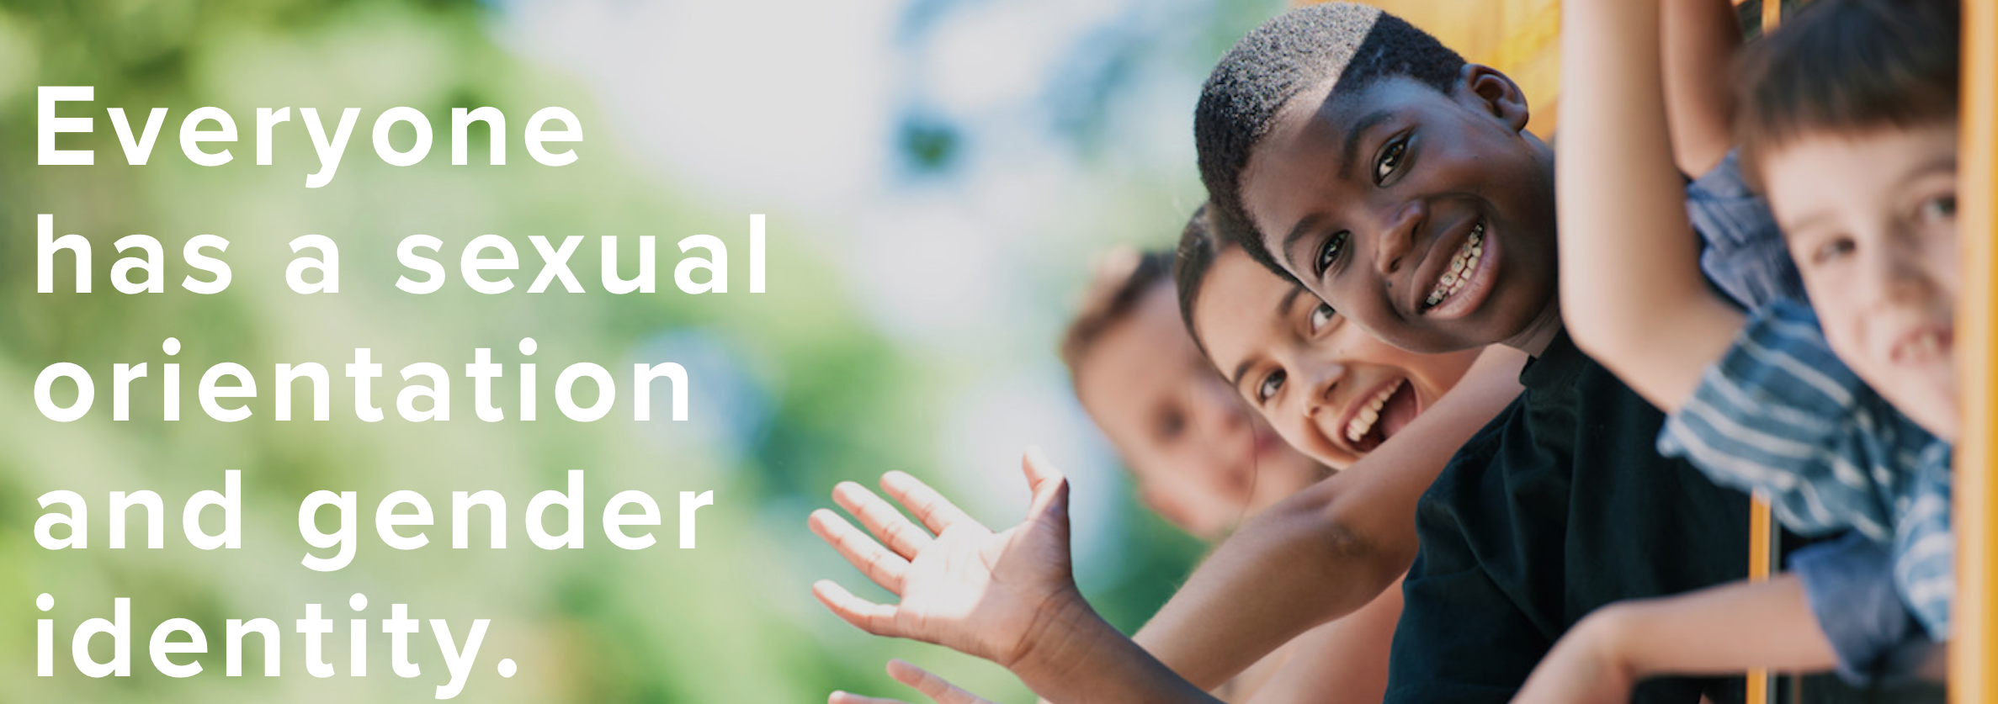
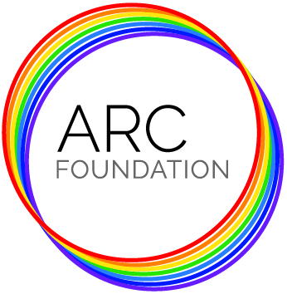
ARC Foundation and SOGI 1 2 3
SOGIeducation.org
Notes:
Introductions
VISION – A world where children and youth of all sexual orientation and gender identities can live their authentic lives
MISSION – To build Awareness, Respect and Capacity through education
SOGI 1 2 3 is the main program, and how we do this.

Slide 3
Introductions
SOGIeducation.org

Slide 4
What is “SOGI”?
SOGI stands for sexual orientation and gender identity.
Different than 2SLGBTQ+
Lesbian, Gay, Bisexual, Transgender, Queer, 2-Spirit, +
SOGIeducation.org #sogi123
Notes:
1 minute
Note: you may want to familiarize yourself with the following terminology in order to clarify for the audience.
Two-Spirit: People of mixed gender roles traditionally revered by many North American Indigenous groups
Cis-gender: A person whose gender identity aligns with the sex assigned at birth
To familiarize yourself with LGBTQ terminology, go to: https://qmunity.ca/resources/queer-glossary/
Sample Script:
Pronounced ”so-jee,” SOGI stands for sexual orientation and gender identity. Since we all have a sexual orientation and gender identity, it includes all of us.
Every student understands and expresses their gender differently, with interests and choices that are common or less common for their biological sex.
Some students may be unsure of their sexual orientation or gender identity. Others may identify specifically as lesbian, gay, straight, bisexual, transgender, queer, two-spirit, cisgender, or other.

Slide 5
What is SOGI-Inclusive Education?
SOGI-inclusive education raises awareness of and welcomes students of all sexual orientations, gender identities and diverse family structures.
SOGI-inclusive education includes conversations in the classroom about diversity at any time. It is not a curriculum or lesson plan.
SOGIeducation.org #sogi123
Notes:
2 minutes
Sample Script:
SOGI-inclusive education is inclusive of SOGI diversity in society and the classroom, and the importance of treating everyone with dignity and respect.
SOGI is one of many topics about diversity discussed regularly in schools, such as when educators speak about race, ethnicity, religion, and ability. SOGI-inclusive education simply means speaking about SOGI in a way that ensures every student feels like they belong. There is no "SOGI curriculum." SOGI is a topic that can be addressed throughout many subjects and school activities.
A SOGI-inclusive school means all of these experiences and identities are embraced and never cause for discrimination.
Example of parents wanting their child removed from “SOGI” – does that mean we can not acknowledge someone has two dads?

Slide 6
Why is SOGI-Inclusive Education Important in BC?
2016 BC Human Rights Code amendment adds gender identity and expression as a prohibited ground of discrimination (joining sexual orientation).
2016 Ministerial directive requires all schools (independent and public) to reference sexual orientation and gender identity in
all policies or codes of conduct.
SOGIeducation.org #sogi123
Notes:
2 minutes
Sample Script:
The Minister of Education announced on September 8, 2016 that all British Columbian boards of education and independent school authorities were required to reference sexual orientation and gender identity (SOGI) in district and school codes of conduct by December 31, 2016.
This directive follows the July 2016 amendment to the BC Human Rights Code, which added gender identity and expression as a prohibited ground of discrimination (joining the already existing inclusion of sexual orientation).
All public school boards were already required to address bullying by having codes of conduct in their schools that articulate all areas protected from discrimination in the BC Human Rights Code—including acceptable and unacceptable behaviours and consequences. These schools are now required to ensure their codes of conduct include behaviours and consequences related to SOGI.
Independent schools are required to similarly update their policies promoting safety, respect and acceptance of all students; anti-bullying and harassment policies; and educational programs addressing these issues.

Slide 7
Why is SOGI-Inclusive Education Important in BC?
64% of students report hearing homophobic slurs such as ‘that’s so gay!’ every day in school. Numbers are consistent across all identities.
GSAs and SOGI-inclusive school policies are linked to better academic outcomes and lowering negative behaviours for all youth, not just 2SLGBTQ+ youth.
Nearly all mental health indicators including suicide rates are higher for LGBQ students compared to heterosexual youth, and higher still for trans youth.
SOGIeducation.org #sogi123
Notes:
1 minute
Sample Script:
Research shows that creating an inclusive school has better outcomes, both academically and socially, for all students.
Numbers come from UBC School of Nursing and Egale.
Sources:
https://news.gov.bc.ca/factsheets/sexual-orientation-and-gender-identity-sogi-in-schools
Saewyc E., Poon C., Kovaleva K., Tourand J., & Smith A. (2016). School-based
interventions to reduce health disparities among LGBTQ youth: Considering the evidence. Vancouver:
McCreary Centre Society & Stigma and Resilience Among Vulnerable Youth Centre.
Saewyc E., Konishi C., Homma Y. & Poon C.(2013) Population-level evaluation of school-based interventions to prevent problem substance abuse among gay, lesbian and bisexual adolescents in Canada. Vancouver: McCreary Centre Society & School of Nursing, University of British Columbia.
Saewyc, E., Wang, N., Chittenden, M., Murphy, A., & The McCreary Centre Society (2006). Building Resilience in Vulnerable Youth. Vancouver, B.C.: The McCreary Centre Society.
: https://egale.ca/backgrounder-lgbtq-youth-suicide/

Slide 8
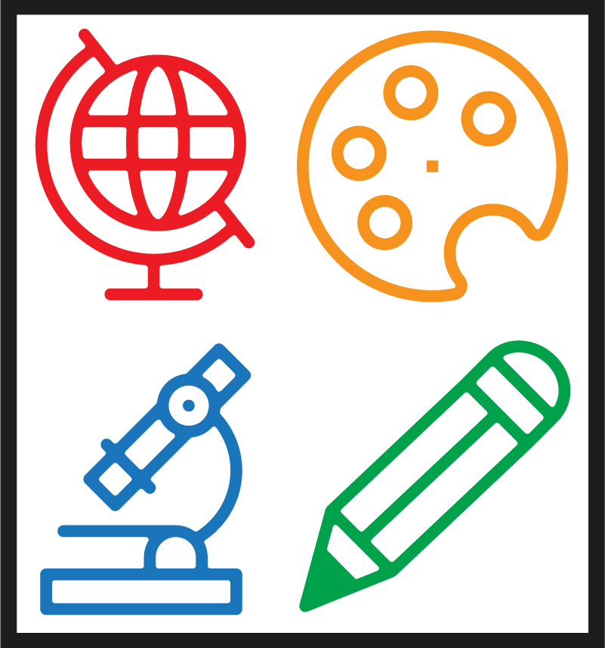
What is SOGI 1 2 3?
SOGI 1 2 3 creates professional development and classroom resources with educators for educators that are ready to use, easy to access, and open to customization.
SOGI 1 2 3 is simply one more way that educators can find the resources they need and learn from each other.
SOGIeducation.org #sogi123
Notes:
1 minute
Sample Script:
SOGI 1 2 3 is not a curriculum. SOGI 1 2 3 is a resource for educators to make their districts, classrooms and schools SOGI-inclusive environments. SOGI 1 2 3 makes educator resources accessible across the province. Educators can choose if and when they want to use SOGI 1 2 3 resources in their classrooms.

Slide 9
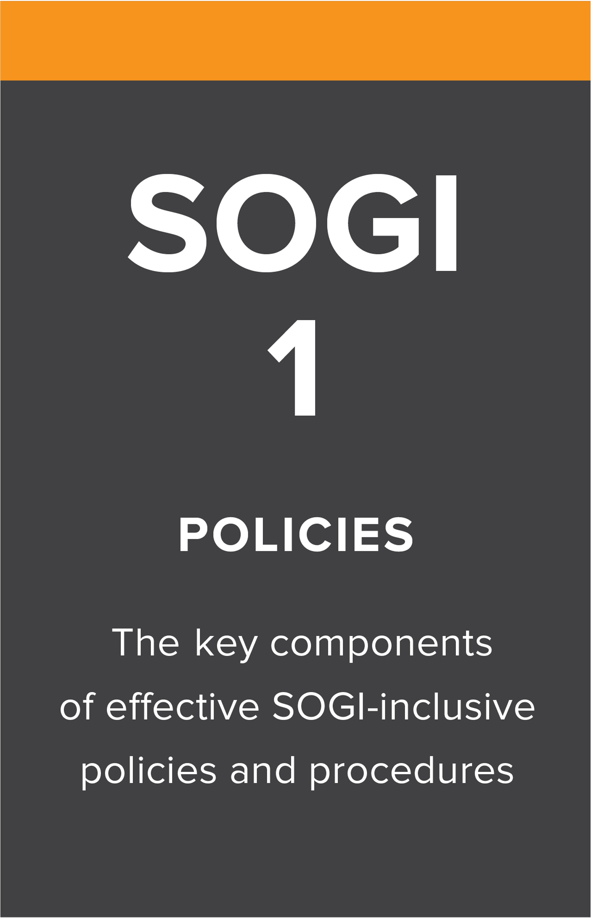
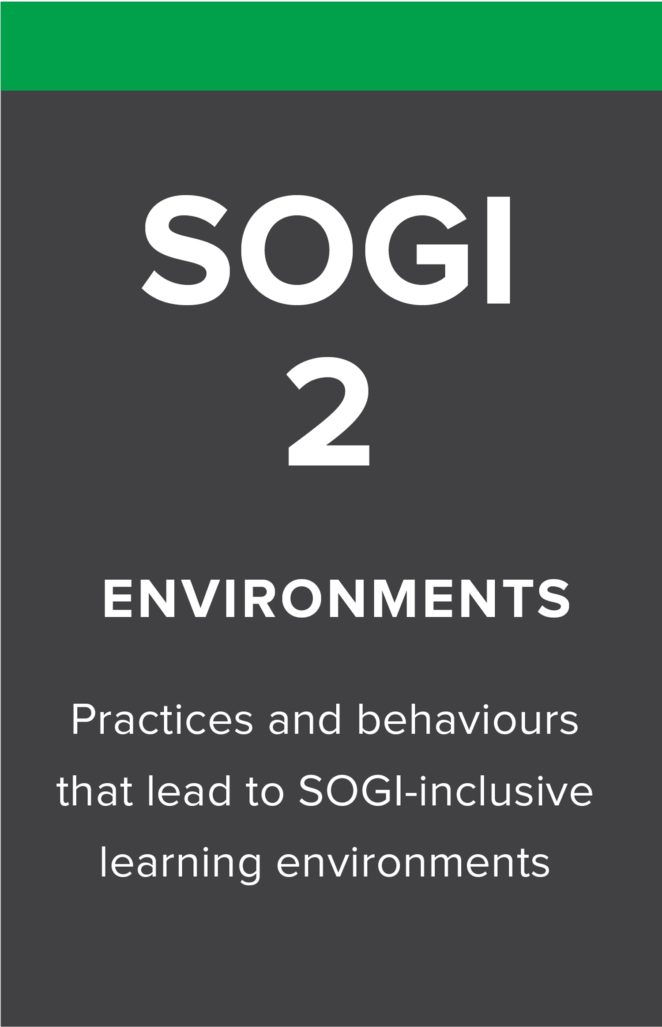
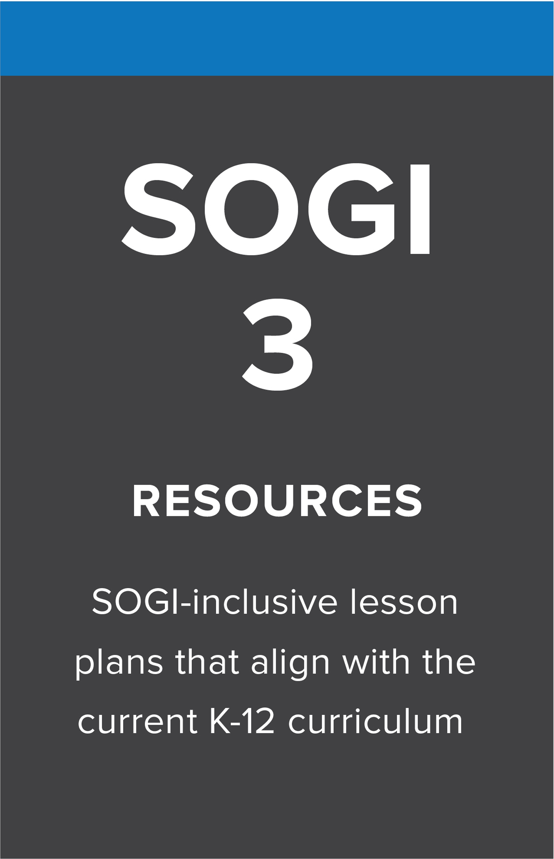
SOGIeducation.org #sogi123
Notes:
4 minutes
Task: present bc.sogieducation.org to show the three pillars of SOGI 1 2 3.
Sample Script:
SOGI 1 2 3 borrows its named from its three-pronged approach to SOGI-inclusive education. When all three pillars of SOGI 1 2 3 are implemented in schools, all parents, staff and students feel more welcome.
SOGI 1: Provides support for districts looking to create standalone SOGI policy and lists 10 key components that were compiled by the Ministry of Education SOGI Working Group Policies and procedures that explicitly reference SOGI have been proven to reduce discrimination, suicidal ideation, and suicide attempts for all students.
SOGI 2: Provides guidance on how to integrate school-wide initiatives and foster and inclusive environment. Inclusive learning environments—including SOGI-inclusive signage, word choices, and extra-curricular opportunities—create a positive and welcoming space for all students.
SOGI 3: Educators can find classroom resources on this page and lessons from K-12. Lesson plans across multiple subjects that teach diversity and respect and include examples of SOGI-inclusive education. This allows learning to reflect the SOGI diversity in students' lives and society.

Slide 10
SOGI Education at YOUR SCHOOL/DISTRICT
Add anything here
SOGIeducation.org #sogi123

Slide 11
Provincial Alignment
SOGIeducation.org #sogi123
Notes:
1 minute
Sample Script:
SOGI 1 2 3 was created by ARC Foundation in collaboration many of these partners and a number of school districts. All of these education partner organizations work together to support SOGI-inclusive education in BC.
The SOGI 1 2 3 Parent Resources were created by ARC Foundation in collaboration with the BC Confederation of Parent Advisory Councils (BCCPAC) and the Ministry of Education.
SOGI 1 2 3 helps build bridges between provincial associations so that change can take place. Many groups have been doing great work in this area for a long time. Aligning their efforts further increases the gains for all.

Slide 12
SOGI-INCLUSIVE EDUCATION provides a MIRROR for some students and families to see themselves reflected and a WINDOW for all students to see the diversity that exists in society.
SOGIeducation.org #sogi123
Notes:
3 minutes
Task: Let participants read this slide to see the connections with SOGI-inclusive education and the new curriculum’s Core Competencies
Sample Script:
Inclusion and diversity are commonly discussed in schools.
Educators ensure conversations in the classroom reflect the diversity that we see in our school communities.
BC’s curriculum (https://curriculum.gov.bc.ca/) includes a focus on valuing diversity and respecting differences. By discussing diversity and discouraging discrimination, students are better able to be themselves, and welcome the differences in their peers.
Proactive and inclusive policies have a positive impact on ALL students as they promote a culture of acceptance and respect.

Slide 13
What Can SOGI-Inclusive Education Look Like?
 | Sexual Orientation (SO) | Gender Identity (GI)
Primary Intermediate Secondary | Family diversity Same-sex families Using “gay” appropriately LGB history, human rights Global LGB rights Discrimination Contributions Artistic expression Political Legal Literature | Gender stereotypes What is Gender Trans history, human rights Global trans rights Difference between gender and sexuality Discrimination Contributions Artistic expression Political Legal Literature
SOGIeducation.org #sogi123
Notes:
2 minutes
Sample Script:
SOGI-inclusive education is about students having conversations about diversity and the importance of treating everyone with dignity and respect. Teachers are best equipped to determine what is age appropriate for their students.
For example, a K/1 lesson on family diversity might teach that families can take many forms; single dads, grandparents, stepparents, or two moms.
Another lesson may discourage students from saying “that's so gay,” in a negative way. SOGI 1 2 3 lesson plans are an optional resource for educators they align with provincial curriculum.

Slide 14
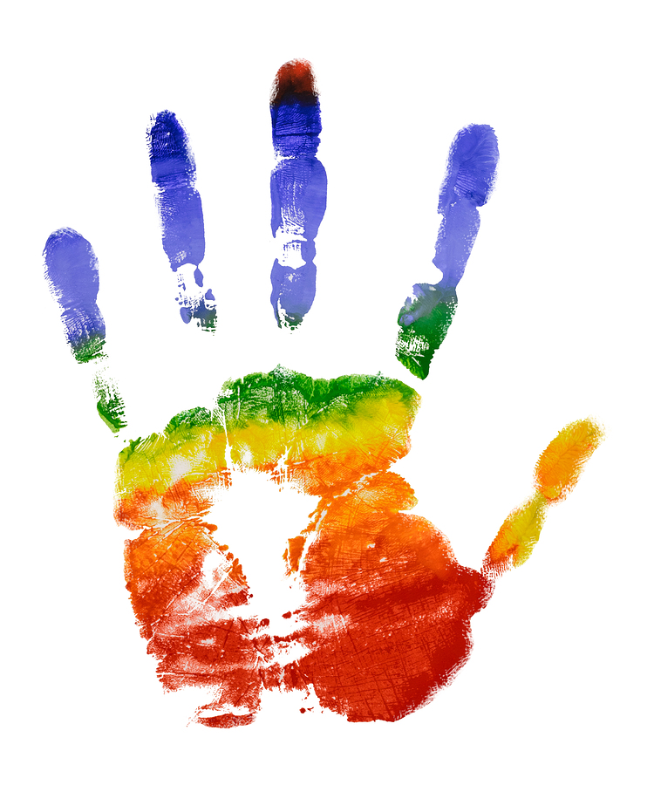
SOGI 1 2 3 in Elementary Classrooms
Example Lesson Plan Templates
SOGIeducation.org #sogi123
Notes:
2 minutes
Note: This slide is option depending on the interests of the audience.
Sample Script
Teaching about SOGI is similar to teaching about religions or cultures – we teach ”about” different religions, but don’t teach that students should be any of those religions.
The lesson plans listed on this slide come from the SOGI 1 2 3 website. Teachers can adjust all lesson plans as they see fit, and all lesson plans are aligned with the BC curriculum.
Each of these lesson plans give teachers ways to start discussions in the classroom. Notice how the material changes as the students mature. For example, primary lessons will be on family diversity and intermediate lessons will discuss stereotypes that we may face.

Slide 15
SOGI 1 2 3 in Secondary Classrooms
Example Lesson Plan Templates
SOGIeducation.org #sogi123
Notes:
2 minutes
Note: This slide is optional depending on the interests of the audience.
Sample Script
Teaching about SOGI is similar to teaching about religions or cultures – we teach ”about” different religions, but don’t teach that students should be any of those religions.
The lesson plans listed on this slide come from the SOGI 1 2 3 website. Teachers can adjust all lesson plans as they see fit, and all lesson plans are aligned with the BC curriculum.
Each of these lesson plans give teachers ways to start discussions in the classroom. Topics can range from sciences, to Indigenous perspectives to gender stereotypes in literature.

Slide 16
GSAs
GSA typically stands for Gender-Sexuality Alliance. There are many other names a school might use.
GSAs are peer support networks run by students and supported by school staff and promote a safe place for all students.
SOGIeducation.org #sogi123
Notes:
2 minutes
Note: This slide is optional depending on the interests of the audience.
GSA typically stands for Gender-Sexuality Alliance.
There are many other names a school might use. GSAs are typically are run by students and ensure a safe place in the school. The group will be sponsored by a staff member, and will meet to discuss topics, organize activities and support one another.

Slide 17
SOGI 1 2 3 Parent Resource Videos
Elementary Classrooms
Secondary Classrooms
SOGIeducation.org #sogi123
Notes:
8 minutes
Task: Introduce and play the video that best suits your audience.
Sample Script:
Next we will watch a SOGI 1 2 3 Parent Resources video that provides more insight into what SOGI-inclusive education and SOGI 1 2 3 can look like in the classroom.

Slide 18
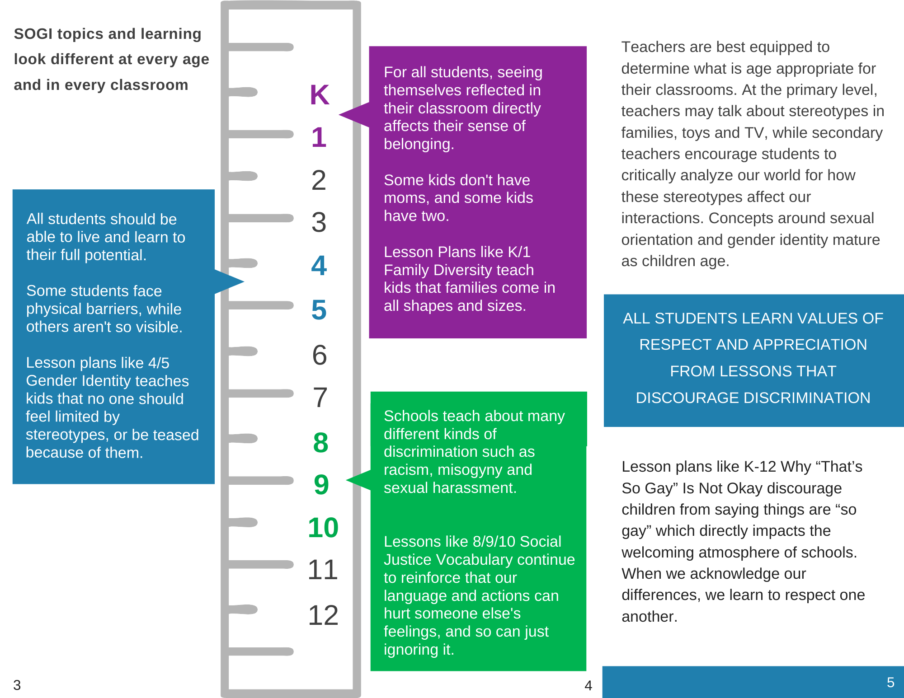
What Can You Do at Home?
Share the values of acceptance and respect
Be curious and learn about SOGI topics with your child
Open up the conversation
Talk to your child’s teacher
SOGIeducation.org #sogi123
Notes:
2 minutes
Task: distribute parent brochure found on SOGIeducation.org/parents
Sample Script:
Kids have questions, and we can be curious together. At home, you and your child can talk about topics of sexual orientation and gender identity with an open mind and a place of acceptance. For example, for older children, parents can pose a scenario that they would like help with. “How do I tell Grandma it’s OK for our friend to be gay?”.
Talk to your child's teachers to learn what they are teaching in the classroom and how SOGI-inclusive education is being achieved at your child's school.
Choose a SOGI-related age appropriate book to read at home and discuss with your children.
Watch the videos on SOGIeducation.org and read more about what’s happening in BC on BC.SOGIeducation.org.

Slide 19
What Can You Do at Home?
If your child comes out (or you think they might)
If your child has questions about others’ gender or sexuality
Community resources: PFLAG, Trans Care BC, youth support groups
SOGIeducation.org #sogi123
Notes:
2 minutes
Sample Script:
Find ways to bring it into conversation. Mention people in your life that are LGBTQ positively. Practice using they/them pronouns for someone you don’t know like a kid at the playground. Example gender stereotypes – affirm that boys can wear pink and have long hair. Drop hints – kids who are looking for you to be affirming will notice.
Choose a SOGI-related age appropriate book to read at home and discuss with your children. Your library will have suggestions, or our website has a book list broken down by age.
Watch the videos on SOGIeducation.org and read more about what’s happening in BC on BC.SOGIeducation.org.

Slide 20
What Can You Do at Home?
Kids have questions.
Be curious together.
Visit SOGIeducation.org/parents
SOGIeducation.org #sogi123
Notes:
1 minute
Task: Encourage participants to learn more and get answers to questions by connecting with you one-on-one, visiting SOGIeducation.org, contacting their child’s teacher, or the SOGI School Lead.
Extension Activity: Open the floor to discussion if time permits.
Sample Script:
Thank you for participating and learning!

Slide 21
We acknowledge the financial support of the Province of British Columbia through the Ministry of Education.
Collaboration Partners:
SOGIeducation.org #sogi123

